Slide 1
Bayesian Classification with a brief introduction to pattern recognition
Paul E. Anderson, Ph.D.

Slide 2
The pattern recognition paradigm
Fruit on an assembly line
  Oranges, grapefruit, lemons, cherries, apples
Sensors measure:
  Red intensity
  Yellow intensity
  Mass (kg)
  Approximate volume
At the end of the line, a gate switches to deposit the fruit into the correct bin

Slide 3

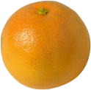



Training the algorithm
Sensors, scales, etc…
Red = 2.125
Yellow = 6.143
Mass = 134.32
Volume = 24.21
Apple

Slide 4
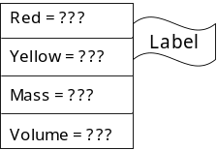
Training (2)
Red = 2.125
Yellow = 6.143
Mass = 134.32
Volume = 24.21
Apple
Classifier

Slide 5
Testing
Red = 2.125
Yellow = 6.143
Mass = 134.32
Volume = 24.21
Classifier
??
!

Slide 6
Pattern Matrix
 | V1 | V2 | V3 | V4 | V5
Ex 1 | 3.06 | 2.05 | 6.39 | 7.84 | 6.75
Ex 2 | 8.25 | 0.72 | 2.52 | 0.50 | 9.08
Ex 3 | 2.72 | 9.32 | 5.68 | 7.83 | 7.86
Ex 4 | 7.37 | 1.30 | 2.97 | 0.61 | 3.49
Ex 5 | 0.73 | 1.46 | 6.60 | 6.08 | 0.78
Ex 6 | 4.85 | 5.08 | 4.87 | 8.06 | 8.65
Ex 7 | 5.89 | 1.23 | 6.38 | 2.81 | 6.84
Ex 8 | 0.52 | 6.57 | 4.08 | 3.62 | 0.59
Ex 9 | 5.66 | 3.65 | 6.87 | 6.90 | 7.93
Ex 10 | 3.92 | 0.73 | 1.01 | 3.57 | 2.47
Ex 11 | 8.84 | 1.42 | 2.79 | 3.40 | 3.19
Ex 12 | 5.63 | 4.32 | 8.08 | 0.82 | 4.74
Class
1
1
1
2
2
2
3
3
3
4
4
4

Slide 7


Nearest Neighbor Classification
Red Intensity (normalized)
1 2 3 4 5 6 7 8 9 10
?
0 1 2 3 4 5 6 7 8 9 10
Mass (normalized)

Slide 8
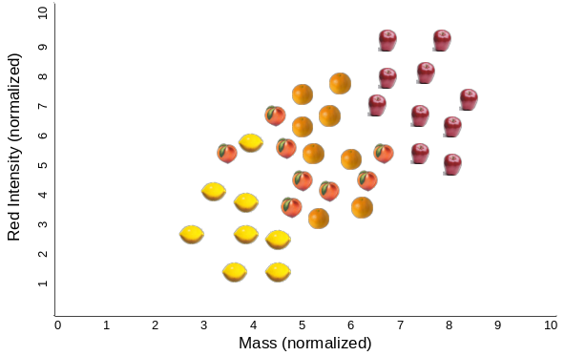
Evaluating Accuracy
Training
data
Testing
data

Slide 9
Problems with KNN classifiers
Lots of memorization
Slow (lots of distance calculations)
Incorrect features cause problems
Features are assumed to all be of equal importance in classification
Odd exemplars (e.g. green/yellow apples) cause problems
What value for k?

Slide 10
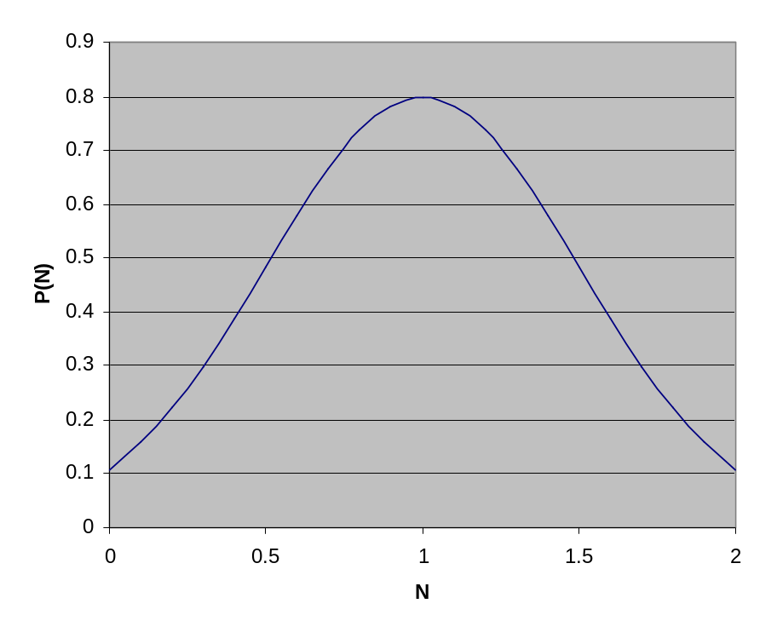
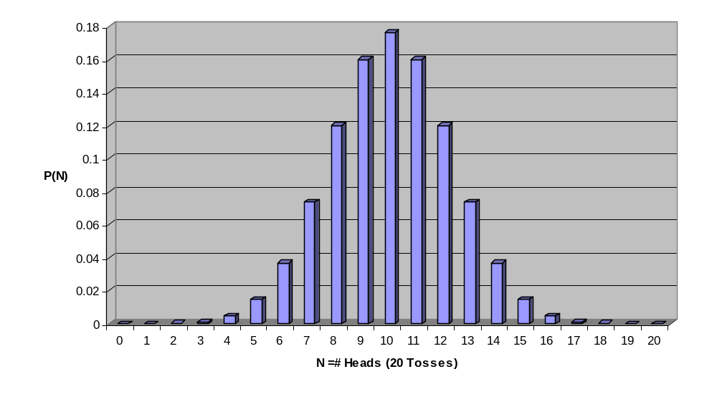
Distributions
Bayesian classifiers start with an estimate of the distribution of the features
Gaussian Distribution
(Continuous)
Binomial Distribution
(Discrete)
Notes:
The sum of discrete values must be 1.0
The area under the curve for a continuous distribution must be 1.

Slide 11
Density Estimation
Parametric
  Assume a Gaussian (e.g.) distribution.
  Estimate the parameters (μ,σ).
Non-parametric
  Histogram sampling
  Bin size is critical
  Gaussian smoothing
  can help
Notes:
Answering the question: how common is it to have feature value x?

Slide 12
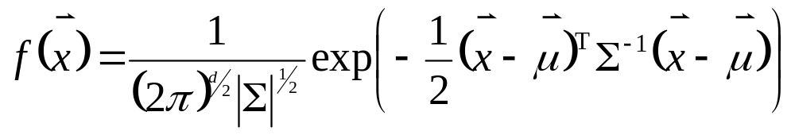
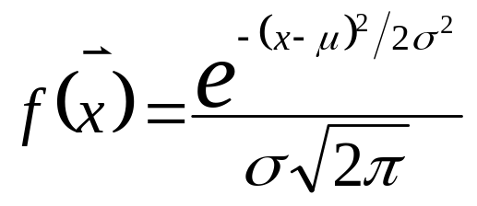
The Gaussian distribution
Multivariate (d-dimensional):
Univariate:
δ
μ
A parametric Bayesian classifier must estimate μ and Σ from the training samples.

Slide 13
Making decisions
Once you have the distributions for
  Each feature
  and
  Each class
You can ask questions like…
If I have an apple, what is the probability that the diameter will be between 3.2 and 3.5 inches?

Slide 14
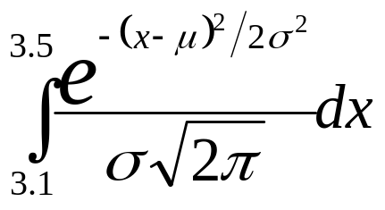
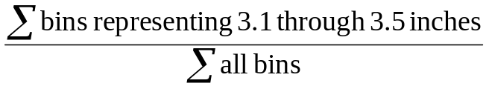
More decisions…
Non-parametric
Parametric
δ
Count
μ
Diameter

Slide 15
A Simple Example
You are given a fruit with a
diameter of 4” – is it a pear or an apple?
To begin, we need to know the distributions of diameters for pears and apples.

Slide 16
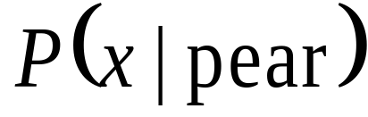
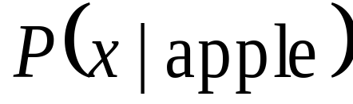
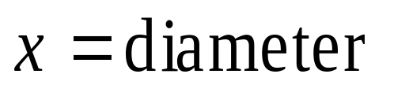
Maximum Likelihood
Class-Conditional Distributions
P(x)
1” 2” 3” 4” 5” 6”
Notes:
Uncommon pear or ordinary apple?
Simple decision rule
Ring example from before

Slide 17
What are we asking?
If the fruit is an apple, how likely is it
to have a diameter of 4”?
If the fruit is a xenofruit from planet Xircon, how likely is it to have a diameter of 4”?
Is this the right question to ask?

Slide 18
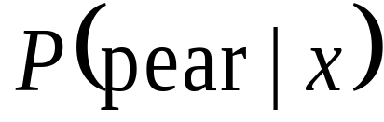
A Key Problem
We based this decision on
(class conditional)
What we really want to use is
(posterior probability)
What if we found the fruit in a pear orchard?
We need to know the prior probability of finding an apple or a pear!

Slide 19
Statistical decisions…
If a fruit has a diameter of 4”, how likely is it to be an apple?
Apples
4” Fruit
Notes:
Which sample is easier to obtain?
Which answers our question?

Slide 20
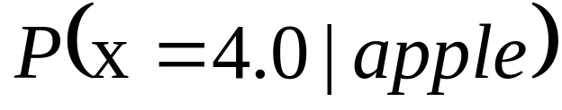
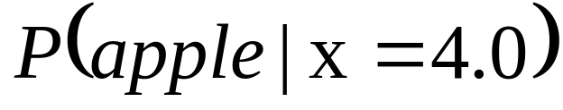
“Inverting” the question
Given an apple, what is the probability that it will have a diameter of 4”?
Given a 4” diameter fruit, what is the probability that it is an apple?

Slide 21
Prior Probabilities
Prior probability + Evidence ⇨
Posterior Probability
Without evidence, what is the “prior probability” that a fruit is an apple?

Slide 22
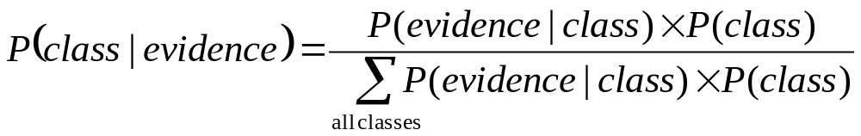
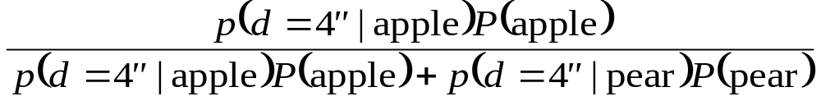
The heart of it all
Bayes Rule

Slide 23
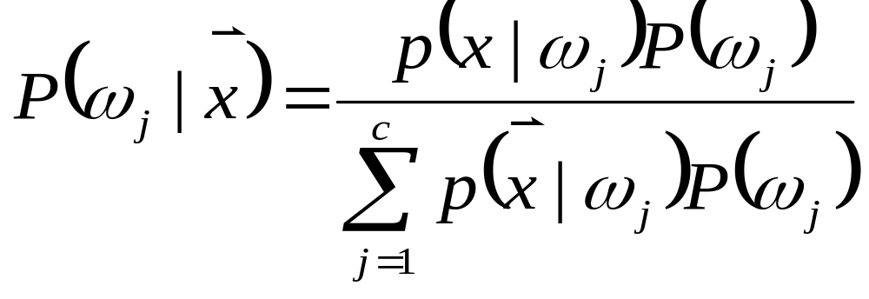
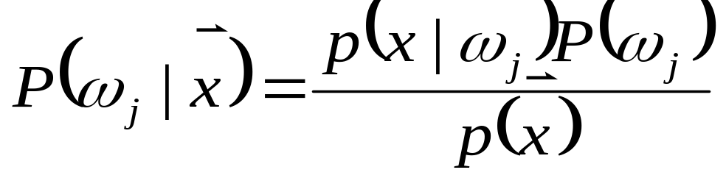
Bayes Rule
or
Notes:
Posterior, prior, and class-conditional probabilities

Slide 24
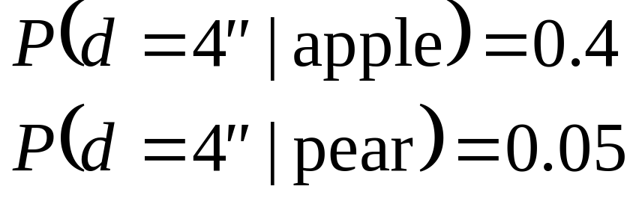
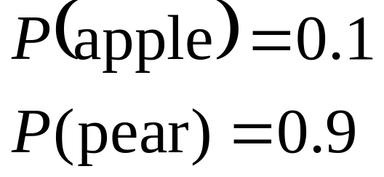
Example Revisited
Is it an ordinary apple or an uncommon pear?

Slide 25
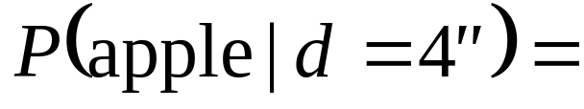
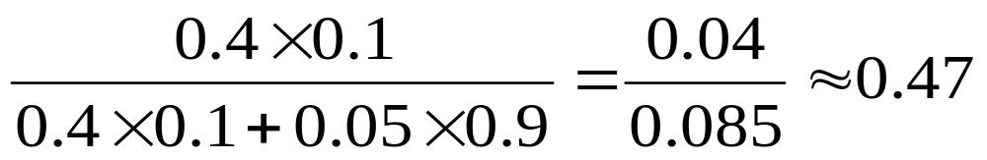
Bayes Rule Example
Notes:
Posterior, prior, and class-conditional probabilities

Slide 26
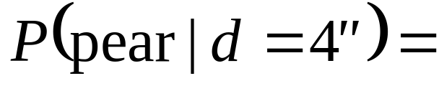
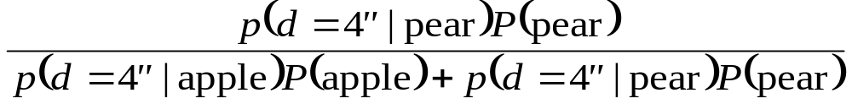
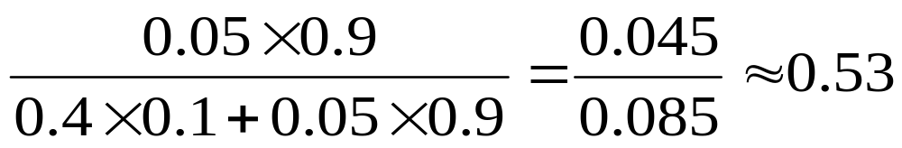
Bayes Rule Example
Notes:
Posterior, prior, and class-conditional probabilities
Two possibilities, note that probs sum to one.

Slide 27
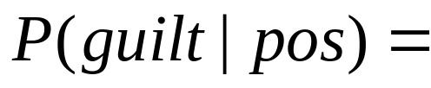
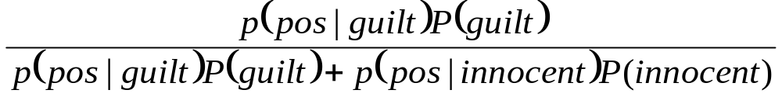
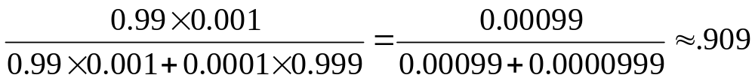
Solution

Slide 28




Marginal Distributions

Slide 29
Combining Marginals
Assuming independent features:
If we assume independence and use Bayes rule, we have a Naïve Bayes decision maker (classifier).

Slide 30
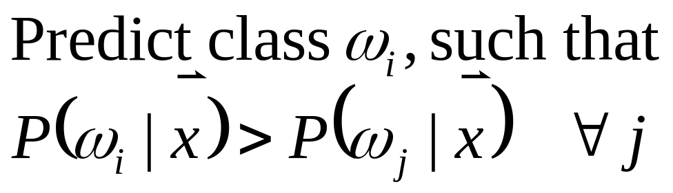
Bayes Decision Rule
Provably optimal when the features (evidence) follow Gaussian distributions, and are independent.

Slide 31
Likelihood Ratios
When deciding between two possibilities, we don’t need the exact probabilities. We only need to know which one is greater.
The denominator for all the classes is always equal.
  Can be eliminated
  Useful when there are many possible classes

Slide 32
Likelihood Ratio Example
÷

Slide 33
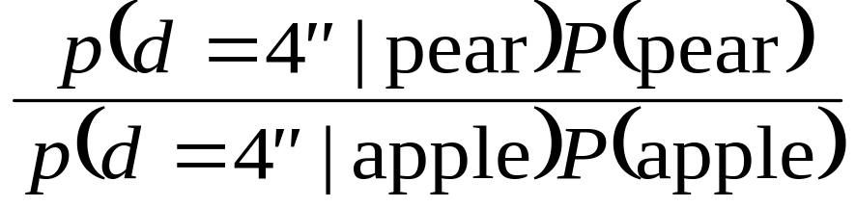
Likelihood Ratio Example

Slide 34
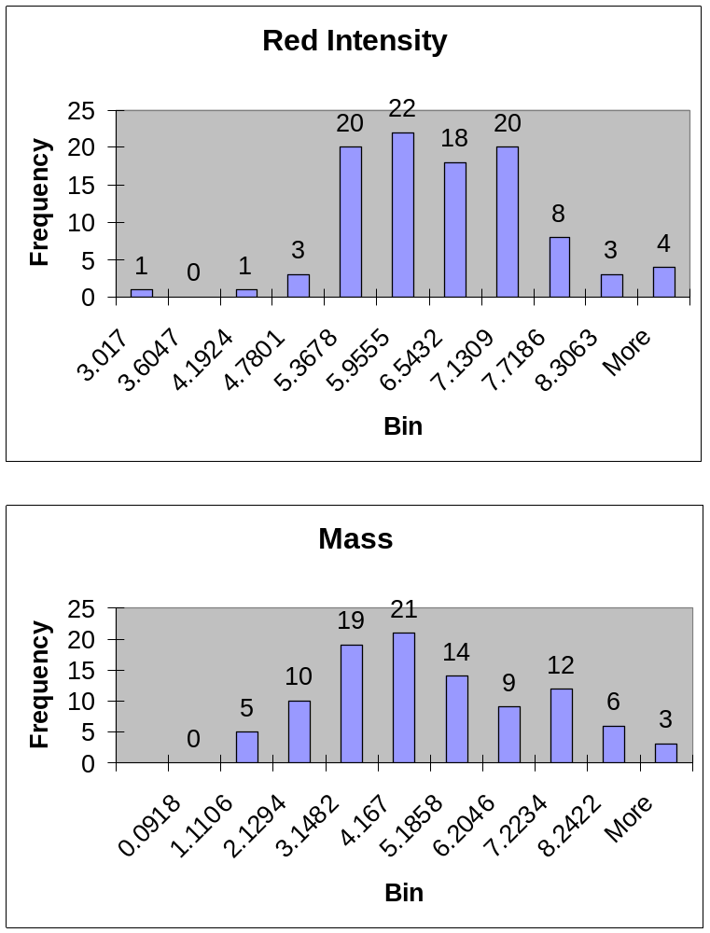
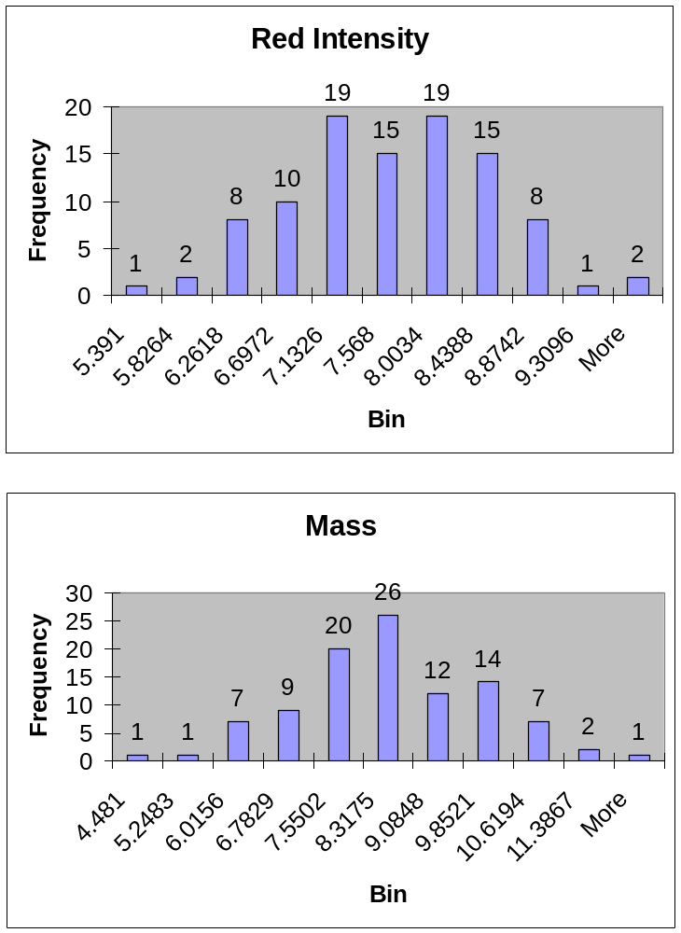
In-class example:
Oranges
Grapefruit

Slide 35
Example (cont’d)
After observing several hundred fruit pass down the assembly line, we observe that
  72% are oranges
  28% are grapefruit
Fruit ‘x’
  Red intensity = 8.2
  Mass = 7.6
What shall we predict for the class of fruit ‘x’?

Slide 36
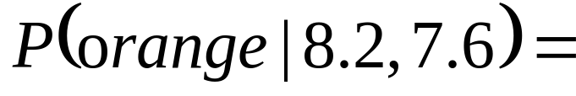
The whole enchilada
and…
(Naïve assumption)
Repeat for grapefruit and predict the more probable class.

Slide 37
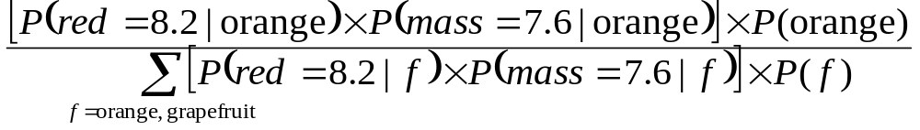
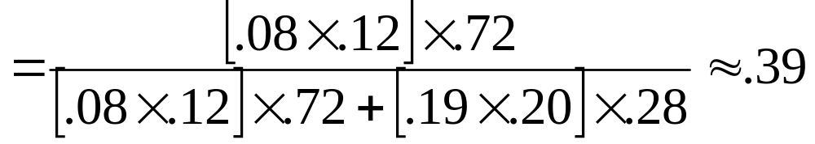
The whole enchilada (2)

Slide 38
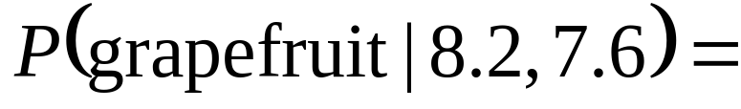
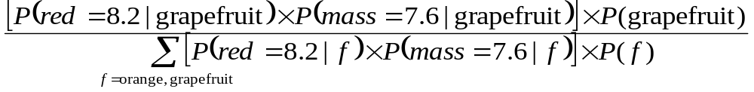
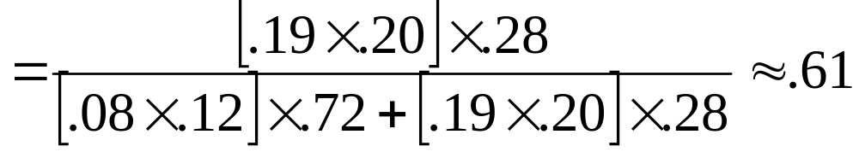
The whole enchilada (3)

Slide 39
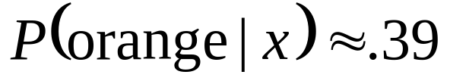
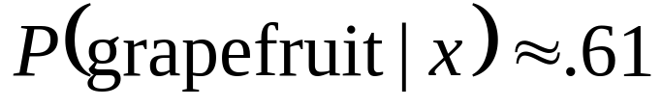
Conclusion
Predict that fruit ‘x’ is a grapefruit, despite the relative scarcity of grapefruits on the conveyor belt.

Slide 40
Abbreviated
Since the denominator is the same for all classes, we can just compare:
and

Slide 41
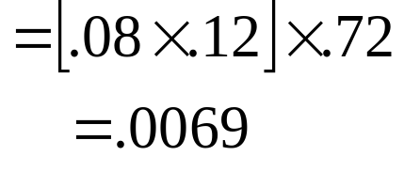
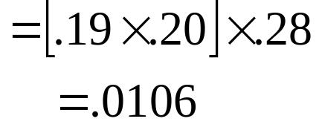
Likelihood comparison

